Slide 1
CHINOOK ANALYSIS
By
Aarushi Shukla

Slide 2

Problem statement
You are hired as a data analyst at Chinook, and your objective is to analyze music record sales data to gain insights and make recommendations for the company's strategy in the physical music market.

Slide 3

Data Description
The database consists of 11 tables, namely-
Album
Artist
Customer
Employee
Genre
Invoice
Invoice line
Media Type
Playlist
Playlist Track
Track

Slide 4
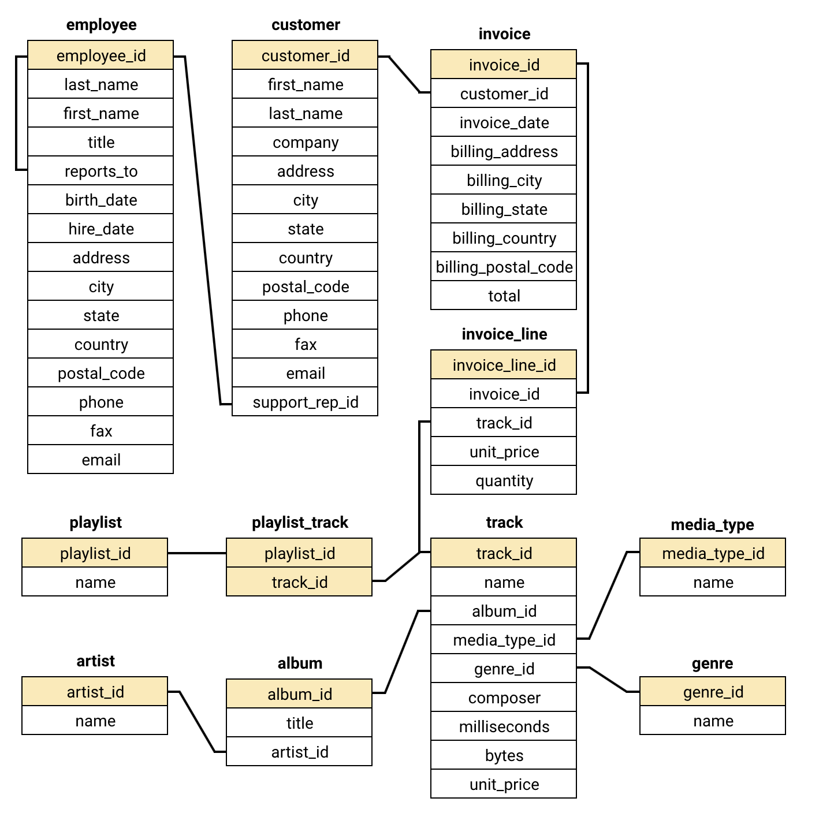
Table-wise Content/ Database Schema-

Slide 5
DUPLICATE AND NULL VALUES
Duplicates found in 'first_name' and 'company' columns of 'customer' table.
Null values in the 'Customer' table for 'fax', 'state', 'company’, and ‘postal_code’.
Null values in the 'Track' table for 'composer’.
Action Taken-
Used coalesce
Kept duplicate records where a clear business need was identified.

Slide 6
TOP-SELLING TRACKS AND TOP ARTISTS IN THE USA
Top-selling track and artists- War Pigs by Cake. Total 6 quantities sold
Most popular genre-
Rock
Highly popular artists-
Nirvana, The Doors

Slide 7
CUSTOMER DEMOGRAPHIC BREAKDOWN
The majority of Chinook's customer base is from the USA, followed by Canada, Brazil, and France.

Slide 8
REVENUE AND NUMBER OF INVOICES
Total revenue for each country, state, and city:
Czech Republic (City- Prague), USA (State- CA, City- Mountain View), United Kingdom (City- London) has the highest total revenue.

Slide 9
Total number of invoices for each country, state, and city:
Czech Republic (City- Prague), Brazil (State- SP, City- Sao Paulo), USA (State- CA, City- Mountain View) has the highest number of invoices.

Slide 10
COUNTRY-WISE TOP 5 CUSTOMERS BY TOTAL REVENUE
Customer with customer id 5 of country Czech Republic has generated the highest revenue.
Customer with customer id 6 of country Czech Republic has generated the second highest revenue.
Customer with customer id 46 of country Ireland has generated the third highest revenue.
Customer with customer id 58 of country India has generated the fourth highest revenue.
Customer with customer id 1 of country Brazil has generated the fifth highest revenue.

Slide 11
CUSTOMER PURCHASING BEHAVIOR
Frequency of purchases- As, customer with customer id 5 purchases a lot of tracks with a frequency of 18 followed for customer with customer id 35 and 13 with frequency of 16 and 15 respectively.

Slide 12
Average order value- Customer with customer id 6 and 13 have the highest average value of 11 .

Slide 13
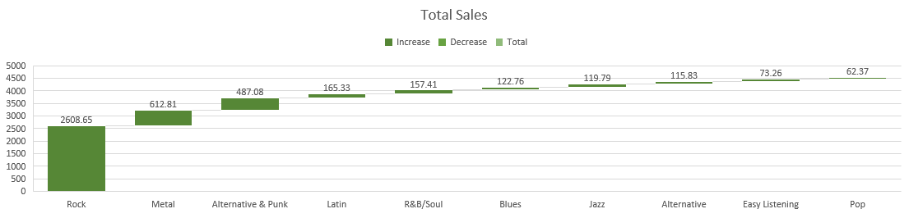
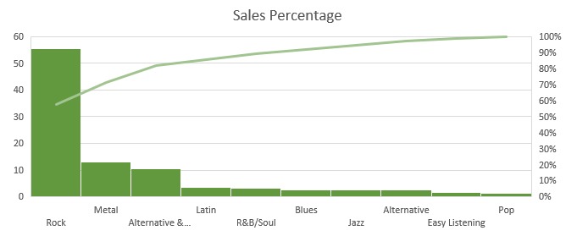
GENRE SALES PERFORMANCE
The genre Rock, bags the highest sales of $555.36 with the percentage of 2608.65.
The genre Metal, bags the second highest sales of $612.81 with the percentage of 22.36.

Slide 14
INSIGHTS
Genre & Artist Preferences- Rock leads the charts, making up 53% of US sales. Artists like Nirvana, The Doors, and Cake are top performers. Metal and Alternative & Punk also show strong global appeal.
Regional Trends- The US brings in the most revenue, but Canada and Germany have higher per-customer spend — ideal for premium offerings. Brazil, UK, and Czech Republic show growth potential.
Customer Behaviour- Churn is low at 1.72% — most customers stick around. Long-term users spend and buy more. 59 inactive customers may need re-engagement.

Slide 15
Purchase Patterns- Rock and Metal are often bought together. Customers also pair artists like System of a Down with Jimi Hendrix — great for bundle deals.
Product Affinity- Albums like Mezmerize and Are You Experienced are frequently bought together — strong candidates for combo offers.

Slide 16
RECOMMENDATIONS
Focus on Top Genres- Rock, Alternative & Punk, and Metal are driving the most sales—especially in key markets. Let’s spotlight these in promotions, recommend them to new users, and create genre-specific bundles to boost conversions.
Tailor by Region- Markets like Canada and Germany are high spenders—ideal for premium offerings. Meanwhile, targeted discounts in countries like Brazil and France can help improve traction. Localizing content based on genre trends will make our campaigns more relevant.

Slide 17
Strengthen Customer Retention- We should consider loyalty perks like reward points or early access deals. Also, identifying customers who haven’t purchased in a while—and re-engaging them with personalized offers—can help reduce churn.
Smarter Product Suggestions- By analyzing what genres and artists are often bought together, we can create smarter recommendations. We can also use customer history and loyalty to suggest curated bundles or tiered offers based on their value.
Monitor What Works- To fine-tune our efforts, we need to track the impact of each campaign. Comparing sales before, during, and after launches will show what’s working—so we can double down on high-impact strategies.

Slide 18
Thankyou
🌱 Let’s protect our planet – avoid printing ppts whenever possible.

